Slide 1
CS3907-80/CS6444-10: Big Data and Analytics Summer 2021 Stephen H. Kaisler, D.Sc.
Lecture 2 –Graph Analytics
“Computer science is no longer just computing and programming, but a domain-focused discipline.”
-S. Kaisler

Slide 2
Graph Analytics
Graph analytics is the application of analytical processes to graphs (a Mathematical structure) for analyzing connectivity among a group of objects.
Four types of analysis:
Path Analysis: Determining features of a path connecting one object to one or more other objects within a graph.
Connectivity Analysis: Determining weaknesses in graphs based on node connectivity.
Community Analysis: Distance and density-based analysis of groups of nodes, their interactions in communities, and their properties.
Centrality Analysis: Identifying the most relevant/important
nodes in a graph, e.g., power, prestige, or finding the most
popular pages – the PageRank algorithm

Slide 3
Graph Theory - I
A graph is defined as a set of nodes and a set of lines that connect the nodes
Mathematically, written as G=(V,E) or G(V,E).
The nodes in a graph represent persons (or animals, organizations, cities, countries, etc.) and the edges (lines) represent relationships among them.
The line between persons a and b is represented mathematically like this: (a, b).
The graph (next page) contains these edges: (a,b), (a,e), (b,d), (a,c), and (d,c).
A subgraph of a graph is a subset of its nodes together with all the edges connecting members of the subset.
subgraph = {a, b, c, d}
The degree of a point is defined as the number of edges incident upon that node: degree(a) = 3
2-3
Notes:
As far as the laws of mathematics refer to reality, they are not certain; and as far as they are certain, they do not refer to reality.
Albert Einstein
Was Einstein right or wrong?
Applications of graph theory to real world problems have led to interesting discoveries and helped us to understand complex situations.
Routing algorithms for laying out electronic circuits on semiconductor chips rely heavily on applications of graph theory.
Airline scheduling of routes almost on a daily basis is another example.
Driving to the grocery store or some other destination is a simpler, but equally germane example.

Slide 4
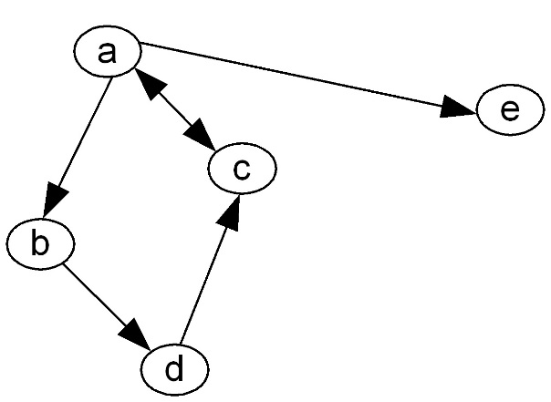
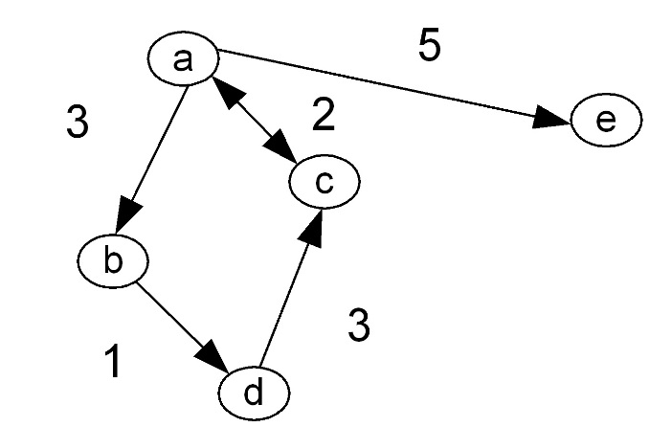
Graph/Network Theory - II
A node with degree 0 is called an isolate.
Nodes are connected by edges:
Symmetric, undirected (e.g. marriage, alliance, warfare)
Asymmetric, directed (e.g. employment, insurgency)
Strength, value (e.g. frequency of interaction, weight)
Valence (positive or negative influence on a node)
If a line connects two nodes, they are said to be "adjacent".
Applying weights to edges increases the complexity of analyzing graphs, but opens up new possibilities of optimization in route planning.
Shortest path algorithms play a role in Social Network Analysis
Notes:
Consider memes.
A meme is the smallest unit of information that can be transmitted through the Internet. It may be a phrase, an image, a audio wave sequence, etc. The definition depends on who is transmitting and receiving it.
Memes have high-level contexts that assist in their interpretation. A picture of a tall, triangular metal lattice structure and the location of Paris, France suggest what?
Note: A meme is not a bit or a character as in Shannon’s communications theory which refer to data.
Shannon–Weaver model of communication: an integrated model of the concepts of information source, message, transmitter, signal, channel, noise, receiver, information destination, probability of error, encoding, decoding, information rate, channel capacity, etc. All this is physical/electronic.
So, tracing routes for how information is transmitted is an important application of graph analytics. The “Invisible College” problem is another.

Slide 5
Graph/Network Theory - III
The two modes connected by an edge are called endpoints.
An edge originating or terminating at a given node is "incident" upon that node.
Two edges sharing a node are said to be incident.
A weighted graph has values assigned to the edges.
In a directed graph, the edges have direction (indicated by arrow heads)
A node has both indegree and outdegree:
The outdegree is the number of arcs from one node to other nodes.
The indegree is the number of arcs coming in to the node from other nodes.
Property 1
Σ_{v} deg(v) = 2m
Proof: each edge is counted twice
Property 2
In an undirected graph with no self-loops and no multiple edges
(i.e. a simple graph)
m ≤ n (n − 1)/2
Proof: No 2 edges can have the same endpoints. Thus, each vertex
has degree at most (n -1). Thus, by above, 2m≤n(n-1)
Notes:
Edges are often assigned weights to indicate the strength of connection, to indicate distance or time, to indicate degree of influence, or other properties.
For example, in SNA, an edge may be labeled with a relationship.
John “loves” Mary. But, there may be many relationships between “John” and “Mary”.
Meshes are graphs/networks with many edges connecting two nodes and appropriately labeled to distinguish the edges.
Suppose, “John is married to Mary”
Two questions could be asked:
Who does John love?
Who is John married to?
We’ll see more of this later when we discuss Conceptual Modeling and Conceptual Graphs.

Slide 6
Graph/Network Theory - IV
Path:
A sequence of alternating nodes and edges
Begins with a node and ends with a node
Two paths are point-disjoint if they don't share any nodes.
Two paths are edge-disjoint if they don't share any edges.
Path Attributes:
A walk is a path with no restriction on the number of times a node can be visited.
The length of a path is defined as the number of edges in it.
The shortest path between two nodes is called a geodesic.
Examples
P₁=(V,b,X,h,Z) is a simple path
P₂=(U,c,W,e,X,g,Y,f,W,d,V) is a path that is not simple
V
a
b
P₁
d
U
X
Z
P₂
h
c
e
W
g
f
Y
5/23/2021
Notes:
As the number of nodes and edges increases, the number of paths between any two nodes, except for those adjacent to each other, will increase.
Node V is connected to nodes U, X, W. These are called the nearest neighbors of V. Sometimes the 1-Neigbors because they are one hop away.
Nodes Z and Y are 2-neighbors of V
Node Z is said to be reachable from Node V by the path VXZ, the path VWXZ, the path VWYXZ, and the path VUWYXZ.
VXZ is the shortest path between V and Z.
Reachability is useful in compilers when analyzing and optimizing program code.

Slide 7
Graph/Network Theory - V
Cycle
A circular sequence of alternating vertices and edges
UaVbXeWcU is a cycle.
Simple cycle
A cycle such that all its vertices and edges are distinct
Examples
C₁=(V,b,X,g,Y,f,W,c,U,a) is a simple cycle
C₂=(U,c,W,e,X,g,Y,f,W,d,V,a) is a cycle that is not simple
V
a
b
P₁
d
U
X
Z
P₂
h
c
e
W
g
f
Y
5/23/2021
Notes:
Cycles (or Loops) are a problem in graph analytics because they can lead to infinitely running algorithms.
For certain applications, we want to eliminate cycles, which we can do by simplifying graphs. For example, in route planning.
In Compilers, when we generate flow graphs, for/do/while loops are treated as cycle in the flow graph.
Recursive algorithms also are modeled as loops.
Note: Recursive algorithms do not have to have functions that call themselves directly, but can have sequence of functions which eventually recurse back to the originating function.
So, VWYXV might be a recursive algorithm, which at termination calls Z.

Slide 8
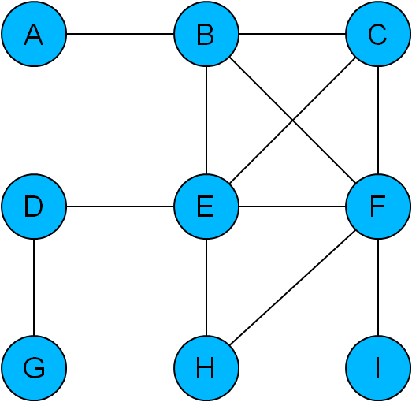
Graphs: Cliques - I
A clique is a complete connected subgraph
In a clique, every node is connected to every other node
B, C, E and F form a clique of size 4
E, F and H form a clique of size 3
A, D, G and I are not part of any clique
Subgraphs identified as cliques are interesting because they
are as tightly connected as possible
are ‘modules’ in the graph
indicate through exclusion sections of the graph that are not so tightly connected
5/23/2021
Notes:
Cliques are a social phenomenon in the real world.
And, are the subject of focused study in many social science domains.
In politics, in PTAs, in local neighborhoods – some people are in and some are out.
Did you belong to a clique in High School?
Do you belong to a social clique?
These can be formal or informal.
Good topic for a term paper:
How to identify a clique in a graph.
Are useful in thinking about fault-tolerant computing.
Are useful in partitioning large parallel processor configurations to dedicate a set of processor to one application.

Slide 9
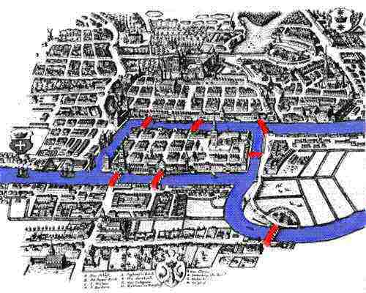
Early Graph Problem
Bridges of Konigsberg:
Is it possible to cross all of the bridges in the city without crossing a single bridge twice?
Euler realised that this problem could be represented as a graph
Does this graph have a path covering every edge without duplicates? (an Euler walk)
In order to have such a path, the graph must have either zero or two nodes with an odd number of edges
It has four, therefore no!
Q: Who is Leonhard Euler??
A: Look him up on Wikipedia
What else is he famous for?
5/23/2021
2-9
Notes:
An early graph analytics problem!
This is the precursor to the Traveling Salesman problem, airline routing, and many other graph analytics problems.
Euler’s solution to this problem is an example of how to solve real world problems:
Transform them from one representation to another and apply the methods of the new representation to solve the problem. Then, transform the results back to the original representation.
But, also recognizing the real problem. Euler saw the land masses as irrelevant. It was the sequence of bridges that had to be crossed which was key.
Euler recognized that “geometry of position” is not about “measurements and calculations”.
Leaning Forward: Although a lot is made of statistical calculations in Analytics, in fact, many analytics are not numerically computational in nature.

Slide 10
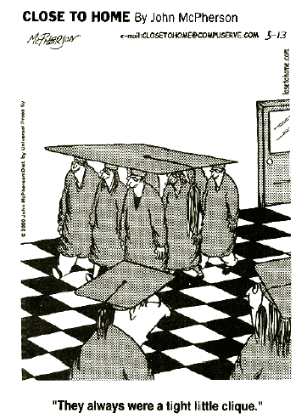
Graphs: Cliques - I
Subgraphs identified as cliques are interesting because they:
are as tightly connected as possible
are ‘modules’ in a graph
Indicate, through exclusion, sections of the graph that are not so tightly connected
There is strong cohesion among the members of the clique.
5/23/2021
Notes:
In software architecture, think about a group of routines as a “clique”.
Does this make sense if I reuse that clique in several places in the architecture?
An interesting problem is identifying a clique in a social network and then investigating its influence as an entity as well as its members influence – individually - influence, prestige, etc. in terms of the behavior of the social network.
Q: in a mesh multiple labeled edges between nodes, is it more difficult o identify cliques?
Q. An individual can belong to more than one clique. How would one rank the prestige of different cliques?

Slide 11
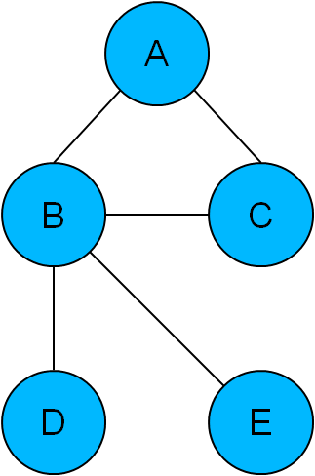
Graphs: Average Path Length
Diameter is the longest path from one frontier node to another.
Shortest paths are
AB, AC, ABD, ABE, BC, BD, BE, CBD, CBE, DBE
Lengths
1, 1, 2, 2, 1, 1, 1, 2, 2, 2
Average path length: 1.5
In graphs with a low average path length, transfer of information between nodes takes place rapidly
Average path length is generally proportional to the size (N) of a network
In small-world networks it is proportional to log N
In scale-free networks it is proportional to log N
5/23/2021
Notes:
In fully-connected networks, a message that starts from a node will eventually reach every other node.
Not so, in sparsely connected networks, especially if the message has a certain perishability, the message will take longer to reach certain or may expire before it reaches all nodes.
Depending on the weights on the edges, the longest path may be the largest number of edges to traverse, or it may be a smaller number of edges, but they may have larger weights.
In R: the diameter is just the number of edge to traverse. But, you need to be careful about you define this.
Make sure your longest path has cycles in it.

Slide 12
Network Definition
A network is a connected graph
A spanning tree of a network is a graph that:
Connects all the vertices via N-1 edges w/ the minimum # of edges
Contains no circuits
Properties:
In a network with N vertices, every spanning tree has exactly N-1 edges
Given a set of N-1 edges that connect all vertices, then it is acyclic
A network with M vertices and N-1 edges has M > N-1.
The redundancy of the network, R = M-N+1.
If R = 0, the network is a tree, and the spanning tree is unique.
If R > 0, there may be several spanning trees.
5/23/2021
2-12
Notes:
Spanning trees occur quite frequently in Computer Science.
Consider the A* search algorithm for AND/OR trees that is used in path planning. It was first used in SRIs Shakey the Robot to plan routes as part of early robotic navigation.
Often the algorithm incorporates heuristics with additional knowledge about the edges and connectivity to find least-cost paths in weighted graphs.
It has been used by railroads for continent-spanning routes given limited connectivity between cities across the US.
See the Wikipedia Article: https://en.wikipedia.org/wiki/Spanning_tree
Good topic for a term paper!

Slide 13
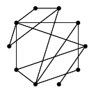
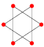
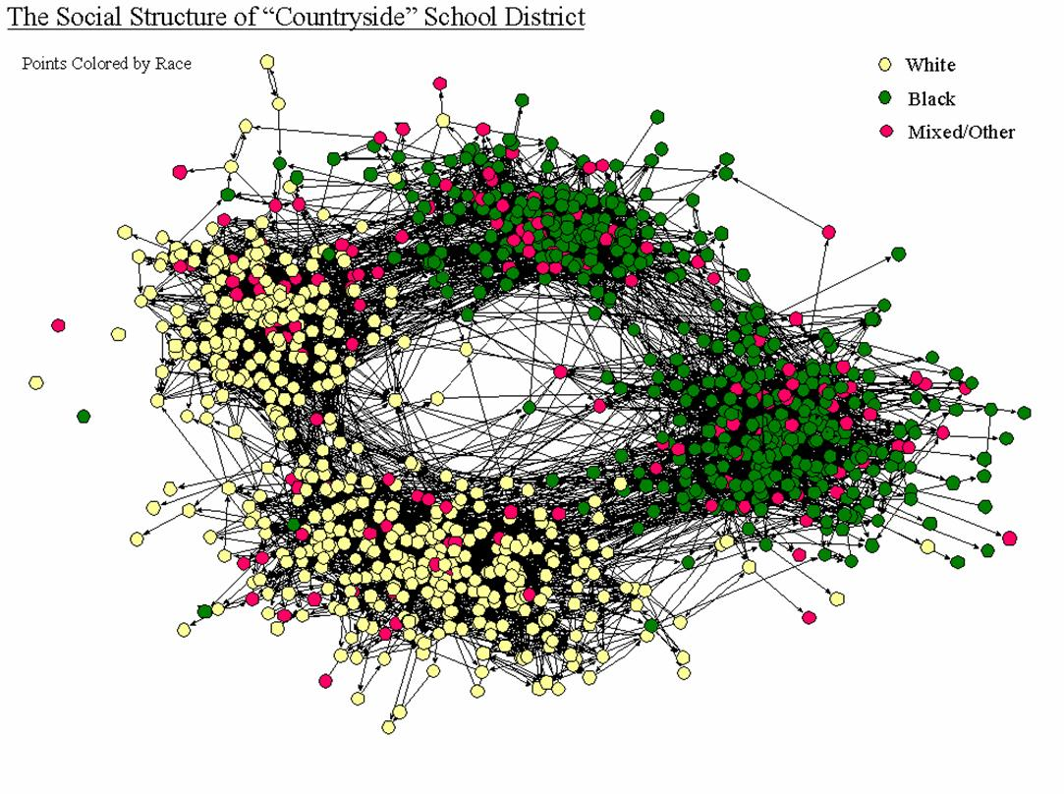
What is a Network?
Most empirical social networks are neither random …
nor regular
but complex …
Are real graphs random?
Why or why not?
Notes:
Networks abound in the real world.
SNA’s rgraph generates random graphs based on a probability of connecting a node to another node.
Random graphs have applicability in certain physical processes based on probability distributions such as Bose-Einstein condensates.
In five minutes, thinking hard, how many networks can you identify from your experience?

Slide 14
Some Graph/Network Properties
Derived from mathematical properties of graphs
Metric | Description
Degree (in, out) | The number of edges to/from a node; a measure of the richness of the node’s participation in the network.
Betweenness | The number of paths passing through a node between a node A and a set of other nodes B.
Path Length | Number of paths from one node A to another node b; the shortest, mean, and longest paths.
Centrality | A measure of the importance of the node based on measuring the number of neighbors reachable within some number of edges.
Closeness | Measures autonomy or independence of a node relative to other nodes.
Prestige | Measured by the number of in-links: P_{i} = IN_{i}/(n-1), where IN is the number of in-links for node i. Prestige is standardized to a value between 0 and 1.
5/23/2021
2-14
Notes:
There are many properties that can be identified and assessed for graphs.
Mathematically, there are theorems and conjectures galore!
When we translate the concept of graphs to the real world, most of these are not relevant.
But, when associate attributes and actions upon graphs, it opens a whole new world of research.
For example, if a network represents a large community or even a population, how fast does it take for a rumor or gossip to propagate through the community from a single source.
Very important when consider the propagation of computer viruses or, even, human viruses, such as our current pandemic.

Slide 15
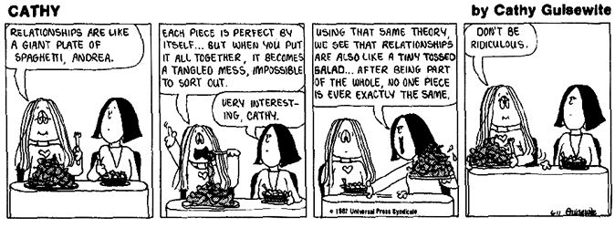
Network Concepts
Network Properties:
Connectivity -- how easy is it to get from one node to another?
A graph is connected if every node is reachable from every other node
Kevin Bacon Game of 6 Degrees of Relationship, based on Stanley Milgram’s small-world discovery of six degrees of separation
Mean geodesic: the average path length over all pairs of connected nodes.
Redundancy: How many different paths connect each pair?
Density: the number of paths divided by number of possible paths
Notes:
When we consider real world networks as weighted or labeled graphs, we will find that many networks have multiple paths between pairs of nodes.
Routes between these two nodes may have different costs or properties depending on the path that you take. But, there may be multiple paths with the same cost, but differ in other characteristics.
Q: Why was the ARPANET created?

Slide 16
Graphs/Networks: Centrality - I
Centrality:
A node-level metric representing its position in the network
Distinguishes “insiders” from “outsiders”; measures the impact of removing a node (and, perhaps, isolating a sub-network)
Degree Centrality: number of distinct relationships or links of a node
Undirected Graph:
C_{U}(i) = Σ x_{ij}; j =1,N and i /= j
C_{U}(i) = C_{U}(i)/(N-1) normalized value
Directed Graph:
Differentiate by "in" and "out" connections based on which way power & influence flow
Centrality is based only on the out connections to other nodes
C_{D}(i) = Σ x_{ij}; j =1,N & i /= j & i → j (out)
C_{D}(i) = C_{D}(i)/(N-1) normalized value
Notes:
Centrality plays a key role in SNA.
See the Wikipedia article: https://en.wikipedia.org/wiki/Centrality
We usually distinguish between indegree and outdegree centrality.
When ties are associated to some positive aspects such as friendship or collaboration, indegree is often interpreted as a form of popularity, and outdegree as gregariousness.
Who are the key actors in a social network? Who has the most influence? Who is the power broker, the message broker, the goto person, etc. These are usually not the same person.
Q: Can you determine what your indegree and outdegree centrality is?

Slide 17
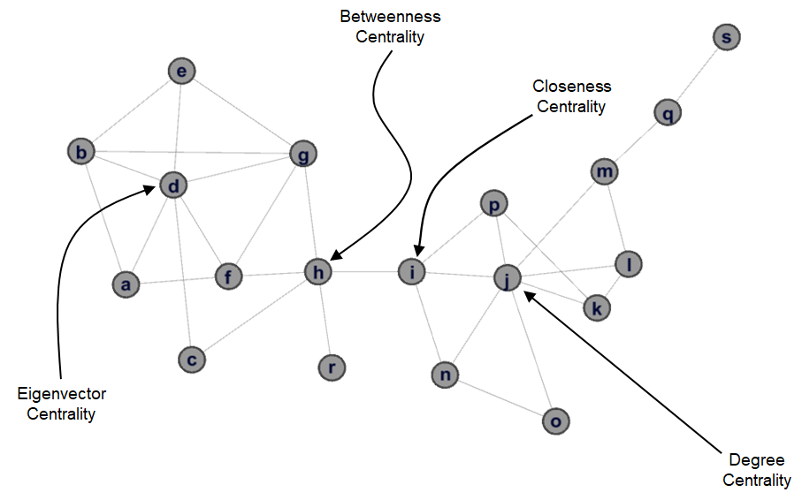
Centrality Example
Source: Discovering Sets of Key Players in Social Networks – Daniel Ortiz-Arroyo – Springer 2010
Notes:
Some types of centrality
closeness centrality of a node is the average length of the shortest path between the node and all other nodes in the graph. Thus the more central a node is, the closer it is to all other nodes.
Betweenness centrality quantifies the number of times a node acts as a bridge along the shortest path between two other nodes. It was introduced as a measure for quantifying the control of a human on the communication between other humans in a social network by Linton Freeman
Eigenvector centrality is a measure of the influence of a node in a network. It assigns relative scores to all nodes in the network based on the concept that connections to high-scoring nodes contribute more to the score of the node in question than equal connections to low-scoring nodes.
Google’s PageRank is a variant of this.
See the Graph Analytics notes.

Slide 18
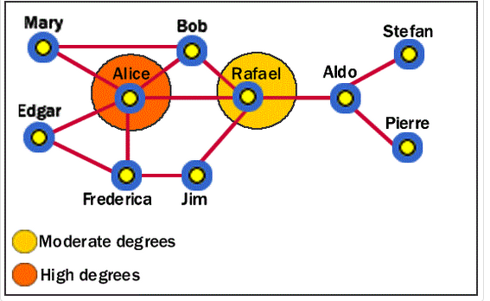
Graphs/Networks: Centrality - II
An entity with high degree centrality:
Is generally an active player in the network.
Is often a connector or hub in the network.
Is not necessarily the most connected entity in the network (an entity may have a large number of relationships, the majority of which point to low-level entities).
May be in an advantaged position in the network.
May have alternative avenues to satisfy organizational needs, and consequently may be less dependent on other individuals.
Can often be identified as third parties or deal makers.
Source: http://www.fmsasg.com/
Notes:
So, Alice is the key person in this graph because she connects six different people
Rafael only connects three, but he is central in the sense that he connects two subnetworks. If we were to somehow eliminate Rafael, the graph would be partitioned into two subnetworks with no communication between them.

Slide 19
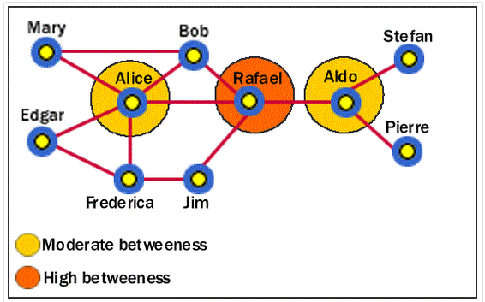
Graphs/Networks: Centrality - III
Betweenness Centrality: identifies an entity's position within a network in terms of its ability to make connections to other pairs or groups in a network
Maximum "betweenness" is for an intermediary node in a star network
Let p_{jk} be the # of shortest paths between nodes j and k (there may be many)
Let p_{jk}(i) be the number of shortest paths passing through node i
Then, C_{B}(i) = Σ p_{jk}(i) / p_{jk} , j < k
Normalized version: C_{B}(i) = (2 * Σ p_{jk}(i) / p_{jk} )/(n-1)(n-2), j < k
Source: http://www.fmsasg.com/

Slide 20
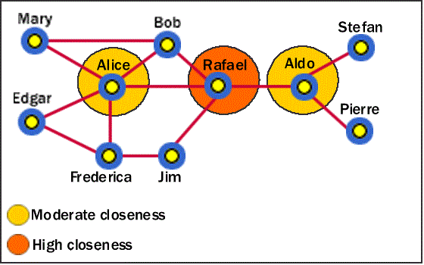
Graphs/Networks: Centrality - IV
Closeness: nodes that can reach other nodes via the fewest intermediaries are relatively independent/autonomous of others
measures how “easily” an entity can access more entities in a network.
Intermediaries serve as attenuators and filters
Let the shortest distance from node i to node j be d(i,j)
C_{c}(i) = (n-1)/ Σ d(i,j), j = 1,N
Source: http://www.fmsasg.com/

Slide 21
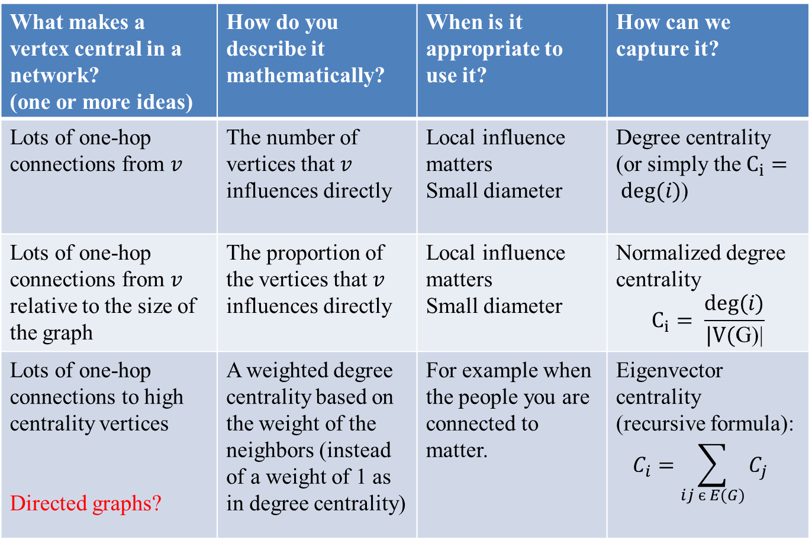
The Idea of Centrality
Source: Centralities,
Ralucca Gera,
Naval Postgraduate School
Notes:
A summary
An interesting term paper topic would be to explore how centrality is interpreted in social networks.
Here is a starting reference:
https://faculty.ucr.edu/~hanneman/nettext/C10_Centrality.html
A short article by Borgatti on centrality:
http://www.analytictech.com/networks/centaids.htm

Slide 22
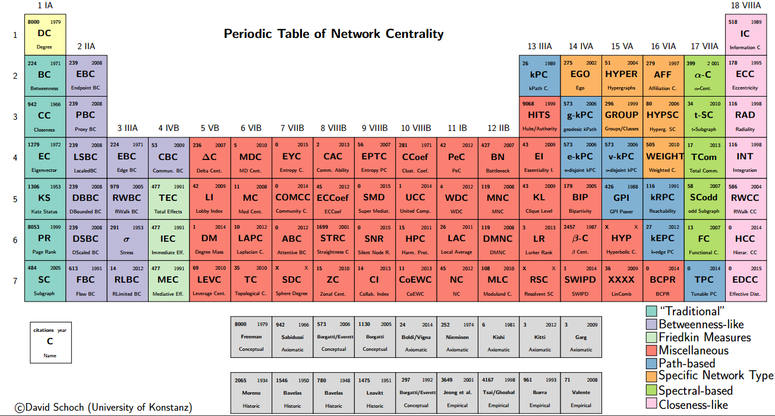
A Periodic Table of Centralities
Source: http://schochastics.net/sna/periodic.html
Notes:
There are many types of centrality!
Term Paper topic:
Pick the centralities from one region , such as light blue or blue; describe, compare and contrast them
Or pick a column, say pink and do the same.
You need to fit the centrality method to the problem at hand, because different centralities give you different information about the graph/network.
Note: There is NO single central node in complex graphs, but many such nodes.

Slide 23
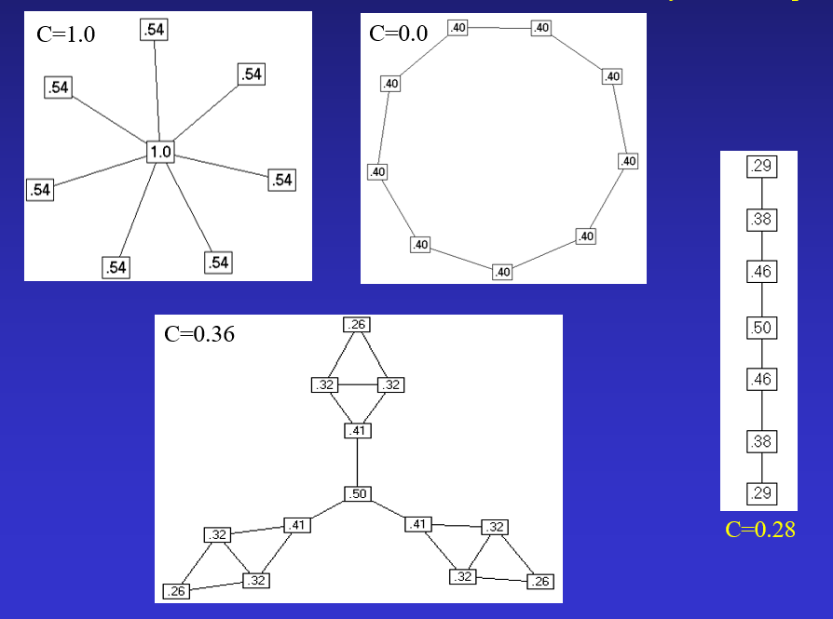
Some Examples of Centrality
Notes:
Student Exercise:
Review the formulas given in previous slides and convince yourself that the values for C are correct.

Slide 24
Graphs/Networks: Prestige - I
A prestigious node is one which is the object of extensive ties as a recipient.
Degree Prestige:
A node is prestigious if it receives many in links from adjacent nodes
So, P_{D}(i) = d_{I}(i)/(n-1), where d_{I}(i) is # of in links for node i
Proximity Prestige:
Considers all nodes that can reach node i
Proximity is defined as closeness or distance of other actors to i.
Let I_{i} be the set of nodes that can reach node i
P_{P}(i) = Σ d(i,j)/ |I_{i}|, j ε I_{i}
Consider the ratio of the nodes reaching i and their average distance
P_{P}(i) = |I_{i}|/(n-1)/Σ d(i,j)/ |I_{i}|, j ε I_{i}
Where the numerator is the proportion of nodes that reach i
5/23/2021
Notes:
Academic prestige is difficult to quantify in objective terms.
Early attempts using this line of reasoning have focused on intellectual genealogy as constituted by supervisor/student networks.
The prestige of different nodes evolves over time – both as member of a network as well as the experience, publications, research, etc. of the individual members.
One of the aspects of your class project is to observe who might be important players from the subset of emails that you pick.
We’ll see an example when we talk about Erdos numbers next week.
See this interesting example:
https://mathshistory.st-andrews.ac.uk/

Slide 25
Graphs/Networks: Prestige - II
Assume nodes are not considered equal according to some attribute.
Suppose we assign some measure of importance to each node, e.g., a rank such as a CEO
If a node’s circle of influence is full of prestigious actors, then the node’s own prestige is also high.
Rank prestige P_{R}(i) is defined as a linear combination of links that point to i:
P_{R}(i) = Σ A_{ji}P_{R}(j), j = 1, n
where A_{ji} = 1 if node j points to node I
Matrix A is the adjacency matrix for the network
An actor’s rank prestige is a function of the rank prestige of the actors whose choose that actor.
Notes:
Rank Prestige is usually where an individual’s prestige is associated with a title, an occupation, a position in some organization, or also marrying someone with such prestige.
Consider that Kate Middleton became Duchess of Cambridge upon marrying William, second in line to the throne of England. Kate was a commoner (not a disparaging statement here). She is now Royalty by virtue of her marriage.
Being elected to, say, the U.S. Senate also carries some rank prestige with it.

Slide 26
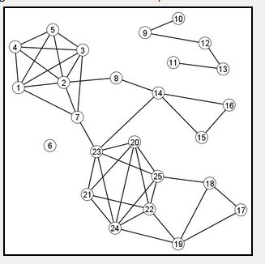
Clusters
Clusters are important features of many problems:
To the extent that Web builders tend to link to sites similar to their own sites, clusters of interlinked Web pages represent collections of content about meaningful subtopics.
Clusters: hard to define mathematically.
Clusters are:
{1,2,3,4,5,7}
{20,21,22,23,24,25}
{14,15,16}
S={9,10,11,12,13} is arguably not a cluster, because the density of that induced subgraph is relatively low.
Ex: Finding clusters is one way to discover meaningful collections of Web pages.
Note: Finding clusters in
graphs is a good term
paper topic
Notes:
A cluster graph is a graph formed from the disjoint union of complete graphs.
In meshes with labeled edges, we can discern clusters where nearby nodes are linked by edges having the same label.
There is a whole branch of graph theory devoted to this.
In social networks, community detection identifies clusters of nodes within networks that, in terms of their neighbors, are internally connected but externally isolated. Generally, the members of a cluster share one or more key properties or opinions.
Think of a fraternity or sorority, for example. Or a terrorist cell.
A number of algorithms exist for finding communities in network data.
This would be a good term paper topic.

Slide 27
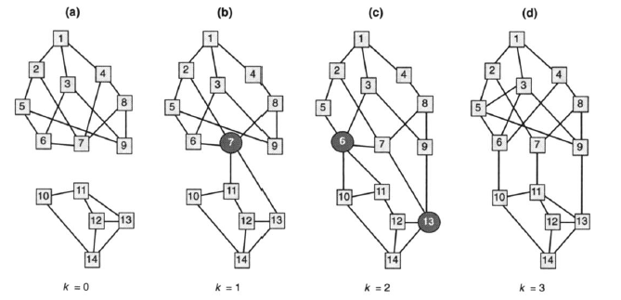
Operations on Graphs
Operations on graphs lead to insights when applied within a particular domain
K-Connectivity:The minimum number of actors you need to remove to break the network in two. You can talk about K-edge-connected vs K-vertex-connected.
K-cutsets: the cliques formed by cutting K nodes/edges out
Notes:
There are many different operations defined on graphs – both mathematically and abstractly, as well as real-world and domain-based.
See the Wikipedia article for starters: https://en.wikipedia.org/wiki/Graph_operations
When we talk about Advanced Analytics, we’ll see an example from Renfro and Dekker, which is illustrative.

Slide 28
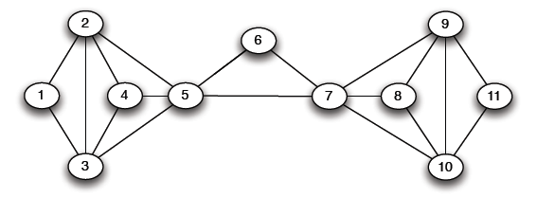
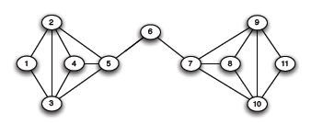
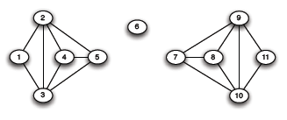
Betweenness Partitioning
Remove edges that are the most “between” to reveal nested networks
So, node 6 is critical
to holding the network
together.
Notes:
Sometimes, we have difficulty in grasping large networks.
We can apply a “divide and conquer” approach using betweenness partitioning, where we isolate subnetworks and analyze them. Once we have their properties and behavior, then we restore links to other subnetworks in an incremental fashion to understand how they interact and, perhaps, contribute to the behavior of the whole.
This is also a useful technique in analyzing large object-oriented programs or large applications. Perhaps, even those implemented using spaghetti code.

Slide 29
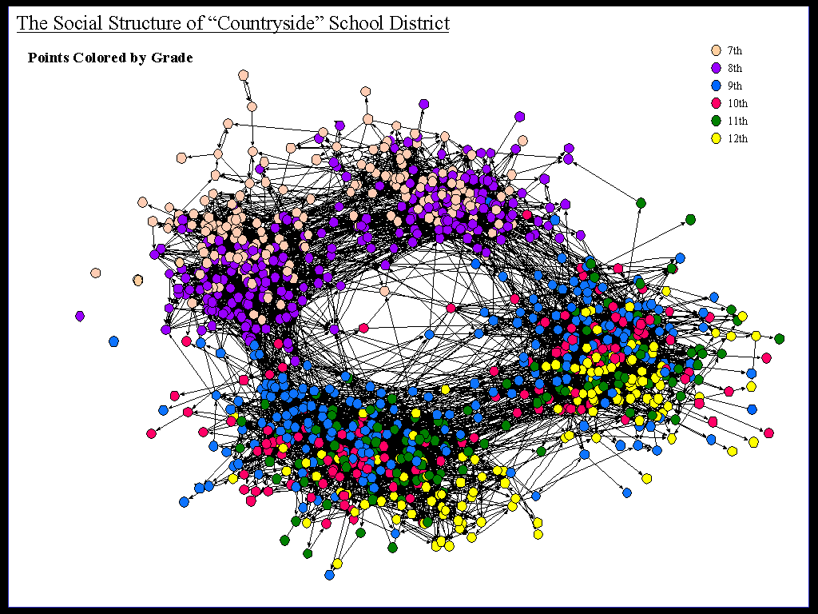
Visualizing Graphs Imparts Information - I
Try to see the distribution of grades among the roughly 5 clusters.
Source: R.J. Thomas A Gentle Introduction to Social Network Analysis
Notes:
Hmmm! Very difficult to understand.
By changing the color of some of nodes for the graph, the display criteria, or even simplifying the graph, we can improve our understanding of what the graph tells.
You are going to experience this Class Project-1.

Slide 30
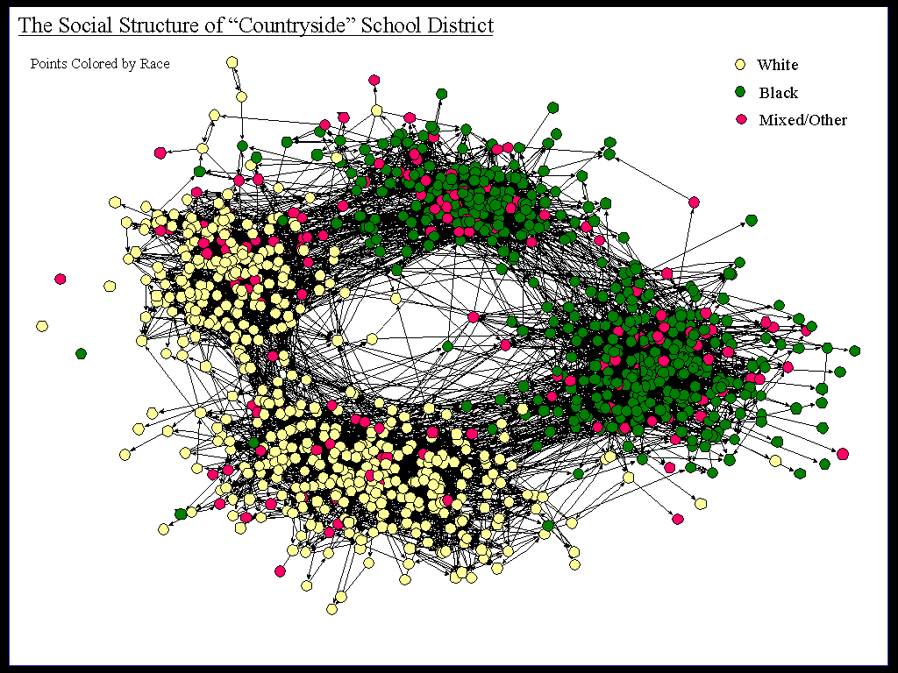
Visualizing Graphs Imparts Information - II
Source: R.J. Thomas A Gentle Introduction to Social Network Analysis
A different picture emerges when a different attribute is colored. Note the distribution by grade. What can you infer from this picture? That many African Americans are not reaching the 12th grade?
Notes:
Graph analytics often requires you to experiment with different criteria for visualization.
Proper visualization depend son the types of questions you are asking of the data in order to understand it.
In this particular study, the authors were trying to understand segregation in a particular community with respect to school attendance.
It is important in graph analytics to determine what attributes are most important focus on them.
But, you often need to experiment with different visualizations in order to determine what are the most important.

Slide 31
Converting a Graph to a Matrix - I
Represent a graph as a matrix:
Row labels and Column labels are nodes of graph
Cell values are # edges connecting Node r (a row label) to Node c (a column label)
Given the following graph, compute the matrix representation:
For each node, label a row and a column in the matrix
For each node, identify the edges to other nodes in the graph
Place 1 in the row = src node and column = destination node
Ex: E goes to B, C, D, F, H
Notes:
Symbolically trying to manipulate large graphs or networks is very difficult.
Often, you can’t see all the nodes due to obscuration by other nodes and edges.
Converting to a matrix representation makes the manipulation of the graph more tractable and opens up a new set of tools for matrix analysis.

Slide 32
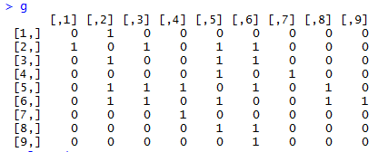
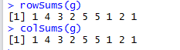
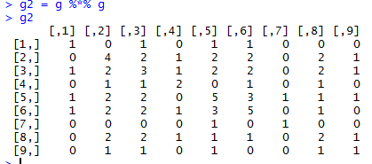
Matrix Calculations - I
a
b
c
d
e
f
g
h
i
a
1
b
1
1
1
1
c
1
1
1
d
1
1
e
1
1
1
1
1
f
1
1
1
1
1
g
1
h
1
1
i
1
So, the reachability of node b to itself [2,2] in g2 is 4.
Convince yourself this is true.

Slide 33
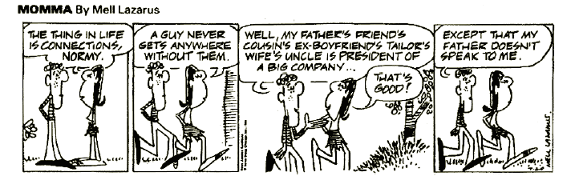
Reachability
Relationships are important in social network analysis,
But…
Notes:
Sometimes it is who you know (or who knows you) and not what you know!
Ultimately, of course, your success will depend on what you know and how you perform.

Slide 34
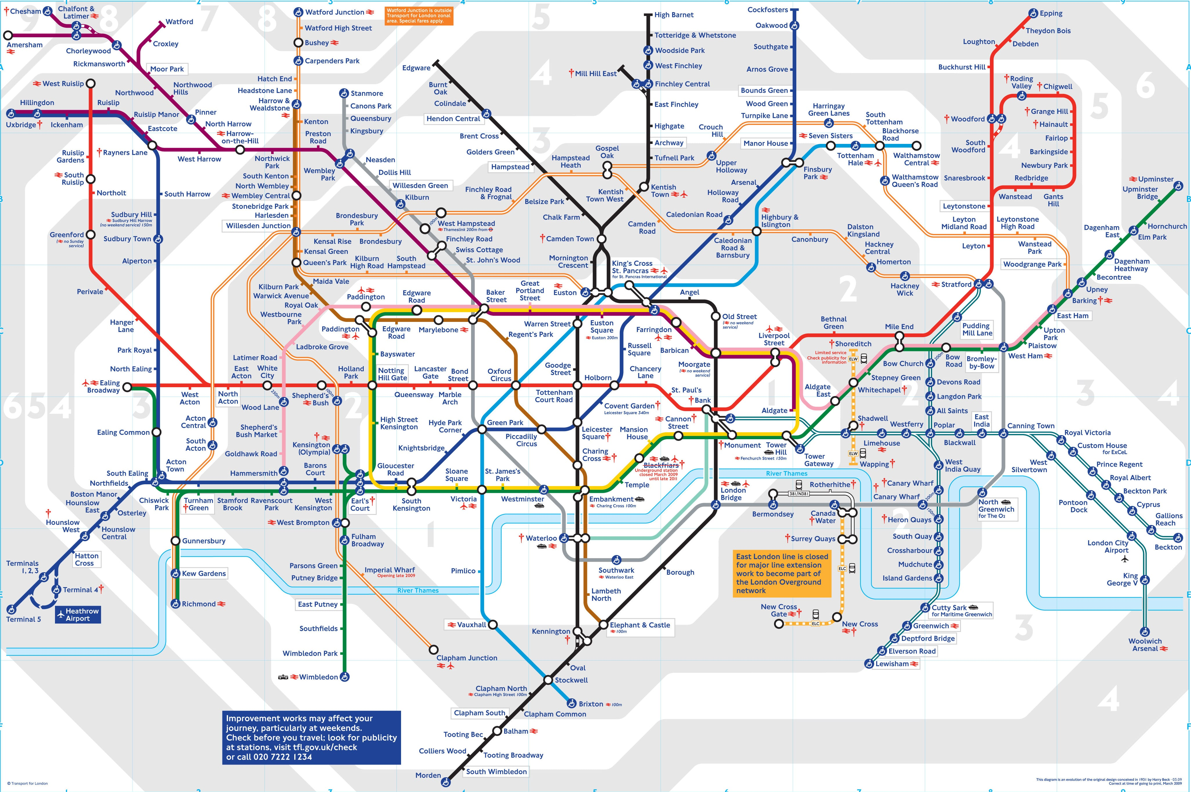
Reachability
Notes:
We mentioned Reachability – how can I get from one place to another.
If you have been to London, you get almost anywhere on the Tube (“Mind the Gap”) by train, bus, and foot. You really do not need a car.
Of course, you always have to check to see which Tube lines are closed on the weekends and find alternate routes.
Indeed, my daughter tells me that you can walk across London proper from North to South in about 90 minutes (some of us take longer).

Slide 35
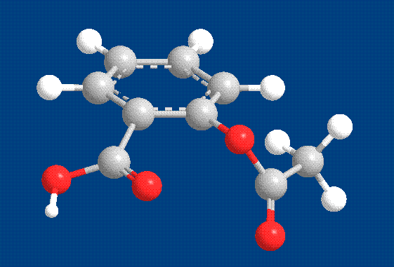
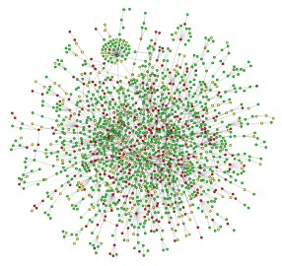
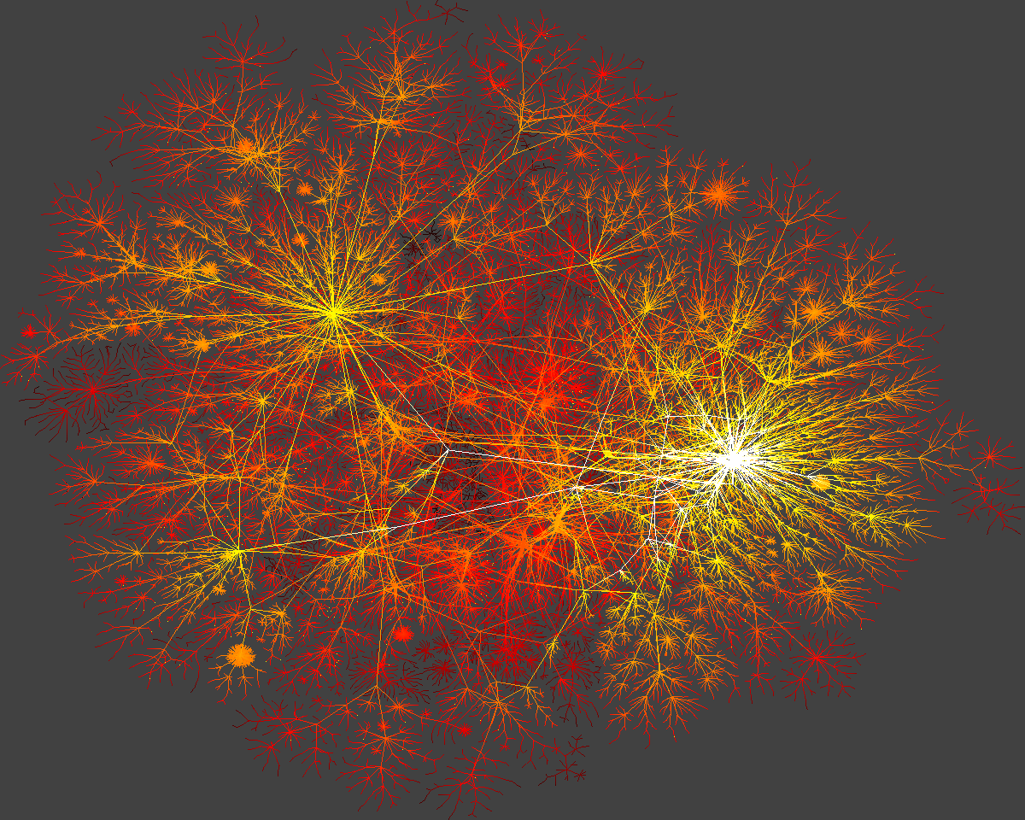
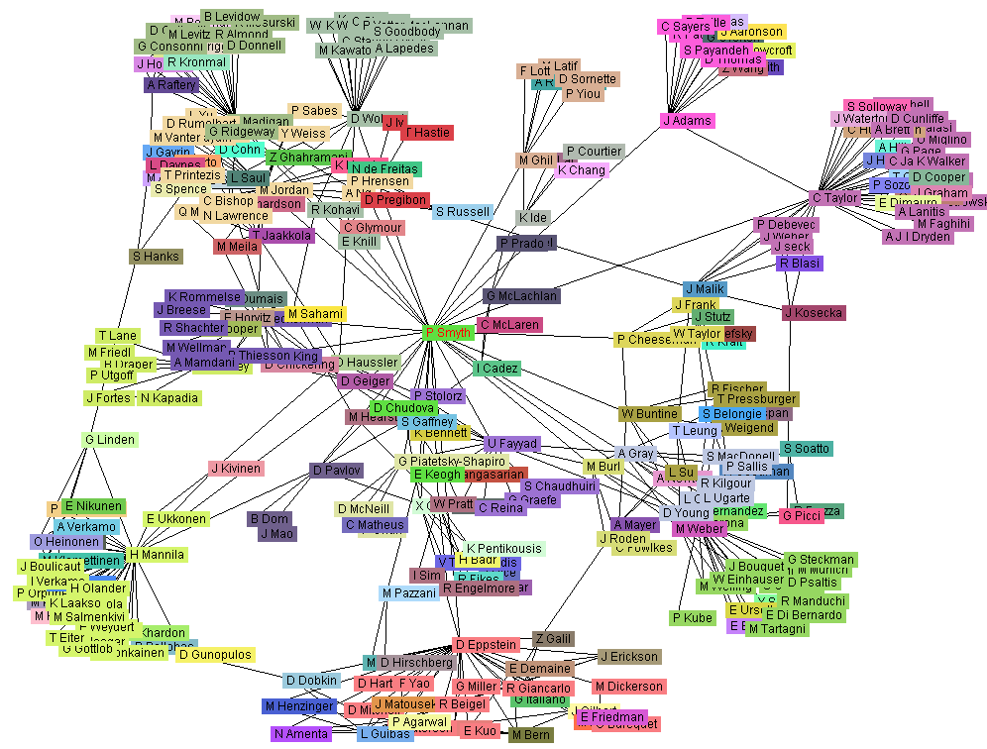
Applications of Graph Analytics: Examples
Aspirin
Yeast protein interaction network
Source: Kardes, Graph Searhing with Indexing, U of Nevada at Reno
An Internet Web
Co-author network

Slide 36
Operations on Graphs
Operations on graphs lead to insights when applied within a particular domain
K-Connectivity:The minimum number of actors you need to remove to break the network in two. You can talk about K-edge-connected vs K-vertex-connected.
K-cutsets: the cliques formed by cutting K nodes/edges out

Slide 37
Betweenness Partitioning
Remove edges that are the most “between” to reveal nested networks
So, node 6 is critical
to holding the network
together.

Slide 38
Social Network Analysis
A method based on formal graph theory
that provides a set of techniques for analyzing the structure of networks
where the linkages between the nodes are well-defined social relations (e.g., cooperation, enmity, trade), including multiple 1-to-1 relations (multiplex).
Used extensively in sociology, anthropology, epidemiology and psychology in the study of human social networks.
Key Ideas:
Network nodes are people (groups), links are relationships (contacts)
Who is connected closely to whom (path length, clustering)?
Who is key in the network (centrality)?
Can we infer a large network structure from a very small amount of data (hidden networks, cells)?

Slide 39
Wasserman & Faust

Slide 40
Some Network Properties
Connectivity -- how easy is it to get from one node to another?
A graph is connected if every node is reachable from every other node
Geodesic: If one node is reachable from the other, what is the shortest path between them?
Kevin Bacon Game of 6 Degrees of Relationship, based on Stanley Milgram’s small-world discovery of six degrees of separation
Mean geodesic: the average path length over all pairs of connected nodes.
Redundancy: How many different paths connect each pair?
Density: the number of paths divided by number of possible paths
Clustering: Given a group of nodes, the number of links between the nodes in the group is greater than the sum of the number of links to nodes outside the group

Slide 41
Why Study Social Networks?
Promotes understanding of complex interactions among similar or diverse entities treated as a group
Metrics fall out of graph theory
Importance of network effects in such systems
How things are connected matters greatly
Details of interaction matter greatly
The metaphor of viral spread for information
Dynamics of economic and strategic interaction
Most people exist in and make decisions based on the influence of many social networks, some of which coincide (i.e., members share more than one social context).
Decisions made in one context (e.g., work) are potentially not only influenced by those in the social network for the formal workplace, but the greater social network(s) spanning multiple contexts in the informal structure.

Slide 42
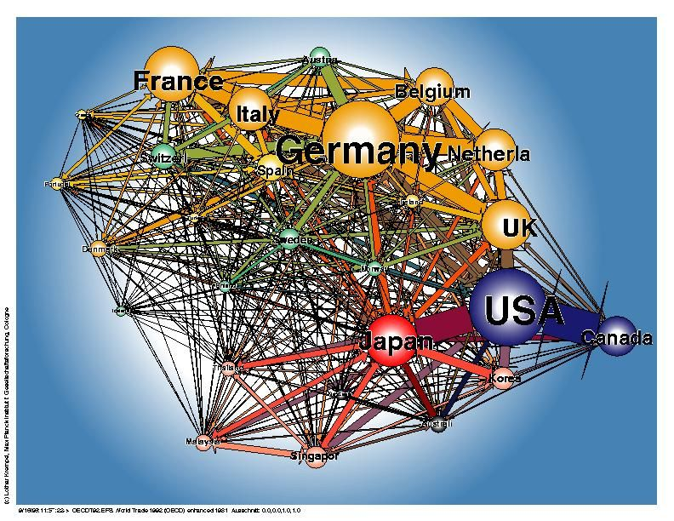
Social Network Analysis: Trade Analysis
Examine the Foreign trade of countries based on the types of products they import/export
Size of spheres is measure of trading volume
Problem: Need better tools to visualize the linkages and navigate through this complex network
Examine over time the fluctuations in the size of the spheres and the flows across the links
© Lothar Krempel. OECD Trade, 1992. New York Hall of Science.

Slide 43
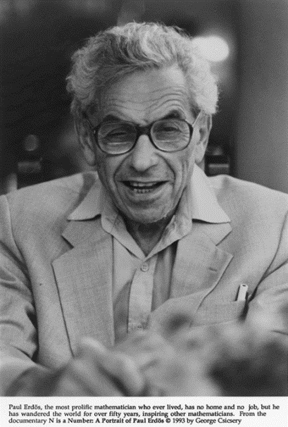
Social Network Analysis: Erdos Numbers
Explore scientific collaboration
Erdos Numbers: http://www.oakland.edu/enp/
Distance of an author to a collaboration with Paul Erdos (d. 1996)
Vertices: math and compsci researchers
Had 507 co-authors
Rules:
If you co-authored a paper with Erdos, your Erdos number is 1
If you co-authored a paper with someone who authored a paper with Erdos, your number is 2
My Erdos number is 4 or 5 depending on path
How does one navigate in such a network?
What does it tell us?
Probably need to augment links with topics of papers
Maybe also geolocations of co-authors
Low Erdos numbers are possessed by many Fields Medalists and Nobel Prize Laureates

Slide 44
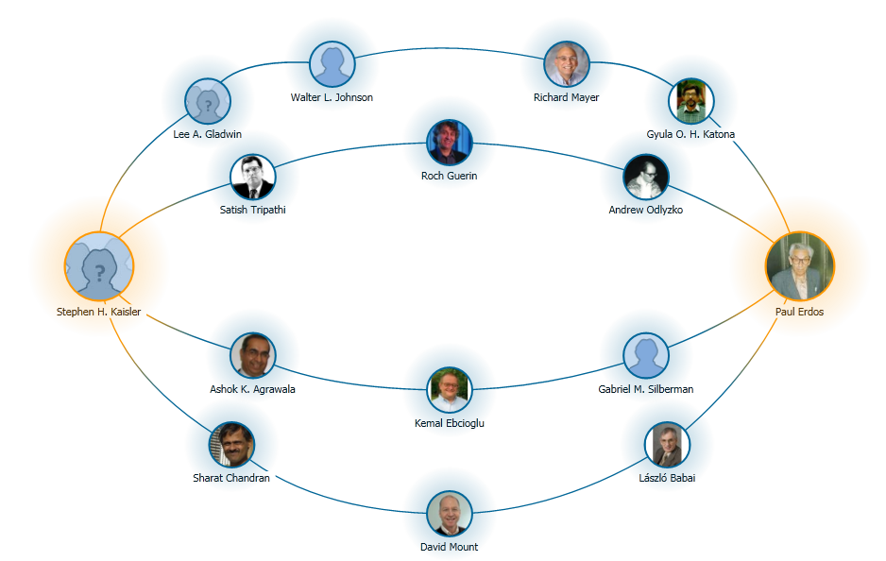
My Erdos Number: 4

Slide 45
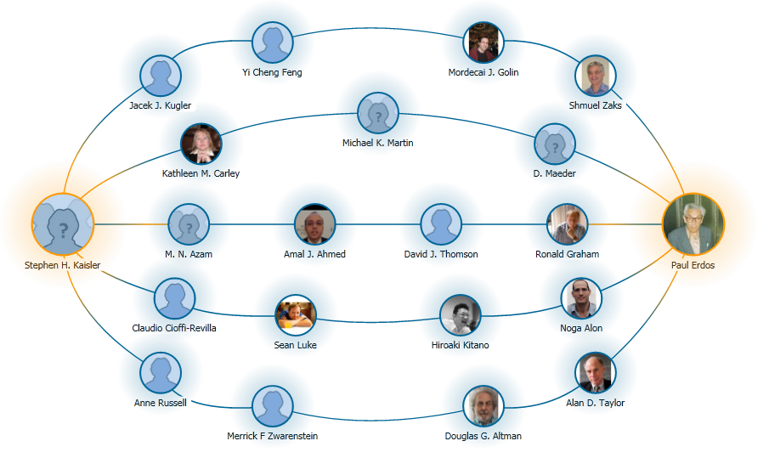
My Erdos Number: 5
So, depending on your co-authors, you Erdos number varies.

Slide 46
SNA: Six Degrees of Kevin Bacon
A game based on the concept of “six degrees of freedom”, which posits that any two people on Earth are six or fewer acquaintance links apart.
Movie buffs challenge each other to find the shortest path between an arbitrary actor and prolific character actor Kevin Bacon.
The computation of a Bacon number for actor X is a "shortest path" algorithm, applied to the co-stardom network:
Kevin Bacon himself has a Bacon number of 0.
Those actors who have worked directly with Kevin Bacon have a Bacon number of 1.
If the lowest Bacon number of any actor with whom X has appeared in any movie is N, X's Bacon number is N+1.
Here is an example, using Elvis Presley:
Elvis Presley was in Change of Habit (1969) with Edward Asner
Edward Asner was in JFK (1991) with Kevin Bacon
Therefore, Asner has a Bacon number of 1, and Presley (who never appeared in a film with Bacon) has a Bacon number of 2.
According to the Oracle of Bacon website, approximately 12% of all actors cannot be linked to Bacon using its criteria.
http://en.wikipedia.org/wiki/Six_Degrees_of_Kevin_Bacon

Slide 47
Flow Model: Basic Ideas
Single commodity flow: influence
Source and sink nodes are individuals who exert or receive influence or both
Edges are drawn between individuals in a unidirectional manner with capacity assigned to each edge based on perceived social closeness.
Social closeness comes from from many factors: communications, meetings, relationships, etc.
Basic idea:
Pairwise measures of social closeness represents the capacity of the potential influence between individuals (Borgatti, 1999)
Social closeness, distance, similarities, or differences can be represented as capacities on the influence between individuals.
Social closeness and similarities are defined to be strictly positive monotonic (greater magnitude implies greater influence).
Social distance and differences are defined to be strictly negative monotonic (greater magnitude implies less influence).

Slide 48
Iranian Government Model
Purpose: understand relative influence of selected individuals in the Iranian government.
Who among Iran's senior leaders has the greatest ability to influence the key Iranian government decision making bodies.
The individual with the maximum influence is a pressure point.
Consider this person as a target for a campaign to change his thinking
Data from: Foundation for Democracy in Iran (FDI) (http://www.iran.org).
FDI provides data for Iran in 1997 with regard to President Khatami's Cabinet, the Council of Expediency and Discernment, the Council of Guardians, the Judiciary Branch, the Majlis, and the Supreme National Security Council.
Some aggregation occurred to make the model simpler.

Slide 49
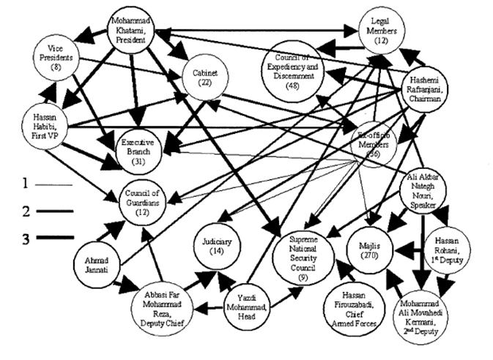
SNA: The Iranian Government Social Network

Slide 50
Iranian Government Model
Weight of edges is depicted by thickness of edge.
Social Closeness between members of a group they are primarily a member of are 3x that of only administrative connections.
Secondary group membership is 2x as important
as administrative connections.
Therefore, there is a ratio of 1:2:3 for administrative:secondary:primary connections.
Edges are directed based on the rules that:
(1) people influence other people and groups down their chain-of command, and
(2) groups influence other groups.

Slide 51
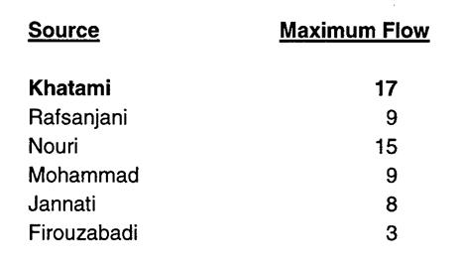
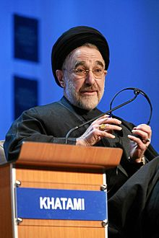
SNA: Influence Example
But, when Renfro and Deckro computed the weighted influence subject to maximizing z – the maximum flow – subject to:
Σ_{j} x_{sj} – z = 0
Σ_{j} x_{ij} – S_{j} x_{ji} = 0 for all i
z - Σ_{i} x_{it} = 0
0 <= x_{ij} <= s_{ij} for all i,j
using the formula for social closeness:
s_{ij} = a(s_{kl}), a > 0, i /= j, k /= l

Slide 52
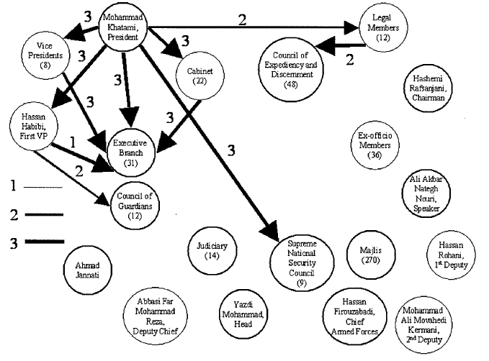
Maximum Flow Solution

Slide 53
But ….
Observe that Rafsanjani was:
once the President of Iran, a member of or closely associated with all of the major governmental departments,
and likely informally retains some or all those membership ties.
Further, observe that Khatami served under Rafsanjani when he was President.
Update the model using this additional contextual data and recalculate the flow.
Additional notional edges have been added to represent Rafsanjani's influence in the informal context

Slide 54

Revised Maximum Flow Model

Slide 55

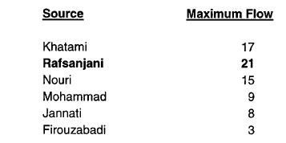
Rafsanjani’s Influence
These results indicate that Rafsanjani
actually has a greater potential to influence key Iranian government decision-making bodies than Khatami.
This result implies that targeting Rafsanjani would result in a greater potential to influence the decisions of the Iranian government than targeting any
other individual senior Iranian leader.

Slide 56
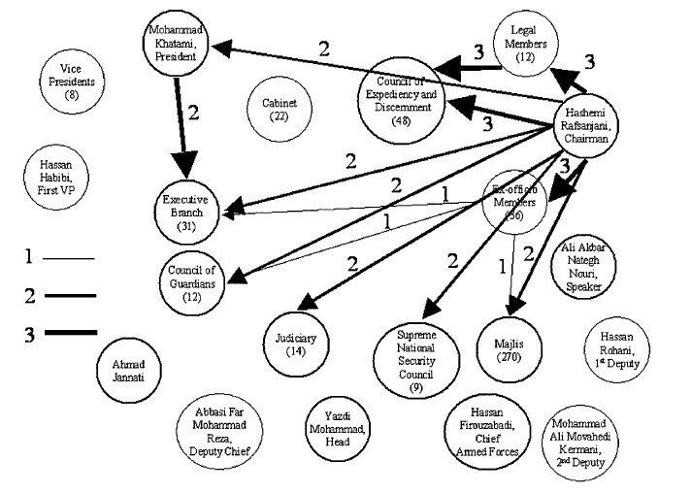
Revised Maximum Flow Solution

Slide 57
SNA: Centrality – Measuring Power
Does success depend on local or distal connections?
Does success depend on the power/centrality of other actors/vertices to which a focal vertex is connected?
Do resources “flow through” intermediary nodes, so that indirect relationships become proxies for direct ones?
Or is centrality more in the way of an indicator of exchange opportunities/bargaining power?
What are the “rules of the game” as regards the activation of multiple relationships?

Slide 58
Graphs & Networks: Challenges
Problem: static algorithms over dynamic graphs do not perform very well; need new algorithms
Problem: sparse graphs are often recast as sparse matrices or sets of sparse linear equations
Just shift the computational burden
Problem: labeling graph nodes and edges with domain information
Problem: sampling a dynamic graph/network at fixed intervals – what can we learn?
Problem: multiple edges connecting nodes lead to multiple paths through the graph? How does the number of paths increase?
Problem: merging or splitting graphs; what are the criteria?
(Equivalent to the Merge Problem in Ontologies)

Slide 59
Social Network Analysis: Challenges
Can be hard to observe relations. You can interview friends, but you cannot interview a friendship, so:
Measure and aggregate attributes of individuals.
Model social life as correlations among individual attributes (e.g. age, race, gender, education, income)
Challenges for current tools and techniques:
Accounting for missing or erroneous data
Modeling dynamic changes in network structure (diachronic change)
Modeling key flows, identify key players
Detecting vulnerabilities
Performing what-if analyses
SNA is largely based on graph theory which today exists at the nexus of topology and combinatorics

Slide 60
Key References
Wasserman, Stanley, and Katherine Faust. 1994. Social Network Analysis: Cambridge University Press.
Scott, John. 2000. Social Network Analysis: A Handbook. London: Sage Publications.
Bienenstock, Elisa J., and Phillip Bonacich. 2003. Balancing Efficiency and Vulnerability in Social Networks. In Dynamic Social Network Modeling and Analysis: Summary and Papers, edited by R. Breiger, K. Carley and P. Pattison. Washington, D.C.: National Academies Press.
Cioffi-Revilla, Claudio. 1979. Diplomatic communications theory: Channels, signals and networks. International Interactions 6 (3):209-265.
Gould, Roger V. 2003. Uses of Network Tools in Comparative Historical Research. In Comparative Historical Analysis in the Social Sciences, edited by J. Mahoney and D. Rueschemeyer. Cambridge, UK: Cambridge University Press.
Tsvetovat, Maksim, and Kathleen Carley. 2006. On Effectiveness of Wiretap Programs in Mapping Social Networks. Computational and Mathematical Organization Theory.
Koschade, Stuart. 2006. A Social Network Analysis of Jemaah Islamiyah: The Applications to Counterterrorism and Intelligence. Studies in Conflict and Terrorism 29 (6):589–605.
Barabasi, Albert-Laszlo. 2002. Linked: The New Science of Networks. Cambridge: Perseus Publishing.
Easley, D. and J. Kleinberg. 2010. Networks, Crowds, and Markets. Cambridge University Press, Cambridge, England, available at: http://www.cs.cornell.edu/home/kleinber/networks-book/networks-book.pdf
Renfro, R.S. II and R. F. Deckro. 2003. “A Flow Model Social Network Analysis of the Iranian Government”, Military Operations Research, 8(1):5-16.

